Slide 1

Atal Bihari Vajpayee-
Indian Institute of Information Technology and Management Gwalior
Computer Graphics Lab : 05
Mid-Point Algorithm
Instructor – Dr. Sunil Kumar
Assistant Professor @ Dept. of Information Technology, ABV-IIITM Gwalior
Teaching Assistants (TAs)
Mehr Aliah, Sheel Patel, Pranav | Group-02
Anushka Agarwal, Abhishek Shrivastav, Radhika Gupta, Aditya | Group-01

Slide 2
Objective of this lab
The objective of this lab is to draw circles and ellipses on a computer screen using the Mid-Point algorithms, while understanding the decision parameters used for efficient curve generation. The lab also involves using the Bresenham line drawing algorithm along with Mid-Point algorithms to construct different graphics using basic geometric shapes.

Slide 3
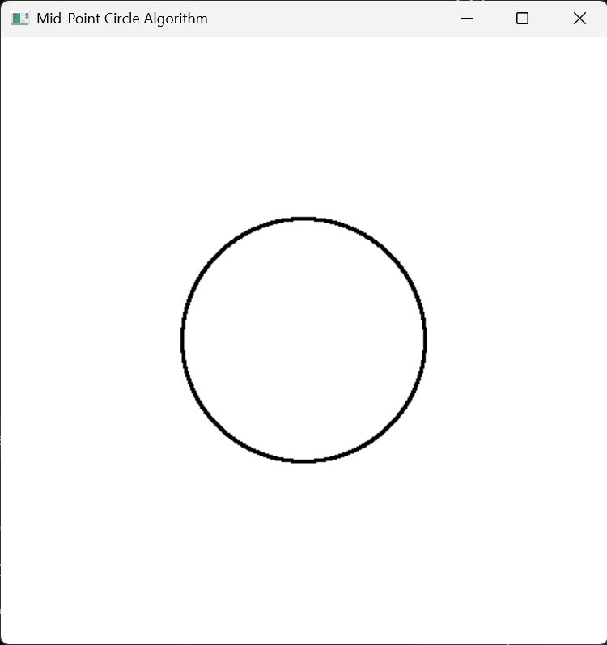
Demo Assignment - 01
#include <GL/freeglut.h>
void plotCirclePoints(int xc, int yc, int x, int y)
{
glVertex2i(xc + x, yc + y);
glVertex2i(xc - x, yc + y);
glVertex2i(xc + x, yc - y);
glVertex2i(xc - x, yc - y);
glVertex2i(xc + y, yc + x);
glVertex2i(xc - y, yc + x);
glVertex2i(xc + y, yc - x);
glVertex2i(xc - y, yc - x);
}
void midpointCircle(int xc, int yc, int r)
{
int x = 0;
int y = r;
int p = 1 - r;
glBegin(GL_POINTS);
while (x <= y)
{
plotCirclePoints(xc, yc, x, y);
if (p < 0)
{
p = p + 2 * x + 3;
}
else
{
p = p + 2 * (x - y) + 5;
y--;
}
x++;
}
glEnd();
}
void display()
{
glClear(GL_COLOR_BUFFER_BIT);
glColor3f(0.0f, 0.0f, 0.0f);
glPointSize(3.0f);
midpointCircle(250, 250, 100);
glFlush();
}
void init()
{
glClearColor(1.0f, 1.0f, 1.0f, 1.0f);
glMatrixMode(GL_PROJECTION);
glLoadIdentity();
glOrtho(0, 500, 0, 500, -1, 1);
}
int main(int argc, char** argv)
{
glutInit(&argc, argv);
glutInitDisplayMode(GLUT_SINGLE | GLUT_RGB);
glutInitWindowSize(500, 500);
glutInitWindowPosition(100, 100);
glutCreateWindow("Mid-Point Circle Algorithm");
init();
glutDisplayFunc(display);
glutMainLoop();
return 0;
}

Slide 4


































Assignment - 02
Question -02 : Use Mid-point algorithm (for drawing circles) and Bresenham Algorithm (to draw lines) to draw the graphics shown below.
$$y$$
$$p_{1}$$
Where,
$$r$$
$$p_{1}=(7.5, 9.2)$$
$$p_{2}=(4.4, 5.4)$$
$$q_{2}$$
$$q_{6}$$
$$p_{3}=(4.4, 0.4)$$
$$p_{4}=(10.4, 0.4)$$
$$q_{1}$$
$$q_{3}$$
$$p_{4}=(10.4, 5.4)$$
$$r$$
$$r$$
$$p_{2}$$
$$p_{5}$$
Other details
$p_{2}q_{1}=q_{1}q_{2}=q_{2}p_{1}$
$$q_{9}$$
$$q_{7}$$
$p_{5}q_{3}=q_{3}q_{6}=q_{6}p_{1}$
$$q_{10}$$
$p_{5}q_{3}=q_{3}q_{6}=q_{6}p_{1}$
$$q_{8}$$
$p_{5}q_{7}=q_{7}q_{8}=q_{8}p_{4}$
$$p_{3}$$
$$p_{4}$$
$p_{2}q_{9}=q_{9}q_{10}=q_{10}p_{3}$
$$r$$
$$q_{4}$$
$$q_{5}$$
$$r$$
$$x$$
$p_{3}q_{4}={\frac{1}{2}q}_{4}q_{5}=q_{5}p_{4}$
$$(0,0)$$
Note: The value of points ($p_{1}$ to $p_{5}$) may chosen differently as per the suggestions of the TAs

Slide 5













Assignment - 03
Question -03 : Use Mid-point algorithm (for drawing circles and ellipses) and Bresenham Algorithm (to draw lines) to draw the graphics shown below.
$$y$$
$$p_{1}$$
Where,
$$p_{1}=(7.5, 9.2)$$
$$p_{2}=(4.4, 5.4)$$
$$p_{3}=(4.4, 0.4)$$
$$p_{2}$$
$$p_{5}$$
$$p_{4}=(10.4, 0.4)$$
$$p_{4}=(10.4, 5.4)$$
$$p_{3}$$
$$p_{4}$$
$$x$$
$$(0,0)$$

Slide 6
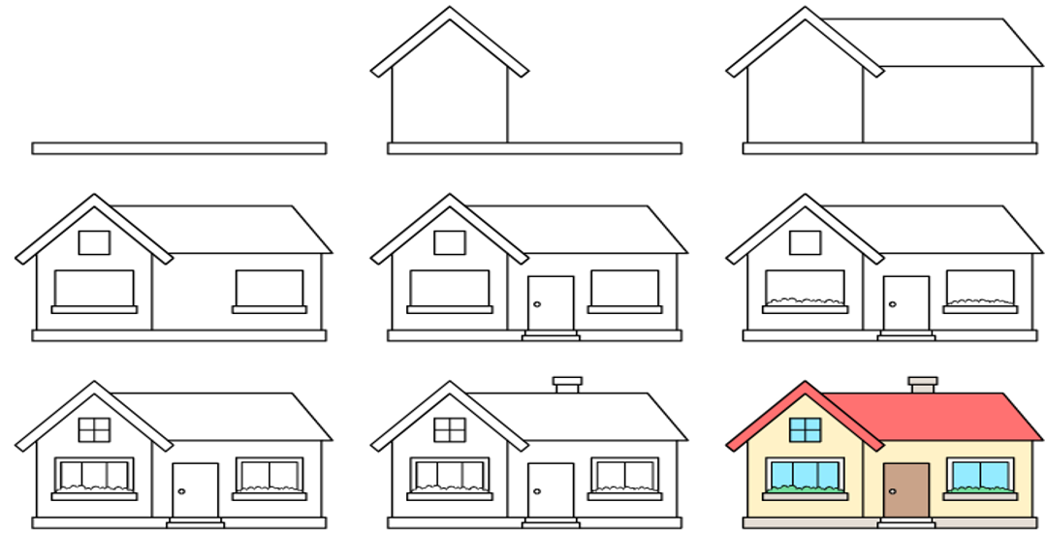
Assignment - 03
Question -03 : Draw the below graphics (final home). Colouring is not required.
https://www.easyartstart.com/how-to-draw-a-house-step-by-step/

Slide 7
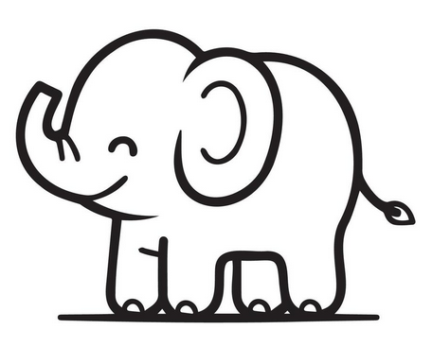
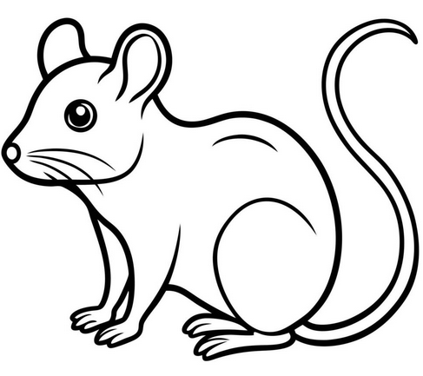

Assignment - 04
Question -04 : Approximate any one of the following using lines and curve and draw it.
(a)
(b)
(c)

Slide 8
Thank you !

